Slide 1
Daily opener
What are pros and cons of performing a survey?
Are they 100% reliable? Why or why not?

Slide 2
Daily Openers
What could make a case study ineffective? Or skew the results?

Slide 3
Write the Questions first- What is the essential ethical value or point of this excerpt?
Why must psychologists consider the welfare and rights of their clients? *Read the below passage to find the answers.
“Psychologists strive to benefit those with whom they work and take care to do no harm. In their professional actions, psychologists seek to safeguard the welfare and rights of those with whom they interact professionally and other affected persons, and the welfare of animal subjects of research. When conflicts occur among psychologists’ obligations or concerns, they attempt to resolve these conflicts in a responsible fashion that avoids or minimizes harm. Because psychologists’ scientific and professional judgments and actions may affect the lives of others, they are alert to and guard against personal, financial, social, organizational, or political factors that might lead to misuse of their influence.” - American Psychological Association Ethics Code

Slide 4
Ch. 2 Notes
“I think therefore I am.”-

Slide 5
Ch. 2 Psychological Methods

Slide 6
Section 1: Conducting Research
Main Idea:
The steps that scientists follow in conducting research are fundamental to reaching reliable conclusions. Psychologists follow similar steps in conducting their research.

Slide 7
Read from pg. 34 together
Rene Descartes, a French thinker of the 17th century wrote a book titled Meditations on First Philosophy
In this book, he helped develop the scientific method.
For Descartes, the body was matter but the mind was spirit. His question was ‘How did the two interact?’
He argued that the two influenced each other through the pineal gland, a small organ in the body.

Slide 8
He thought that all sensations that needed to be combined to be processed – such as the separate images from each eye – come together in the pineal gland.
Years later, the very scientific method that Descartes helped to create provided the means to disprove his theory.

Slide 9
Descartes can be credited with helping psychology become a real science.
Just watch the first 4 minutes:
https://www.youtube.com/watch?v=CAjWUrwvxs4

Slide 10
Psychologists use a variety of research methods to study behavior and mental processes.
These methods differ, but psychologists tend to follow the same procedures when conducting their research.

Slide 11
Scientific Method
Question
Hypothesis
Experiment
Results
Conclusion
Replicate
Theory
PHEOC
Problem, Hypothesis, Experiment, Observation, Conclusion

Slide 12
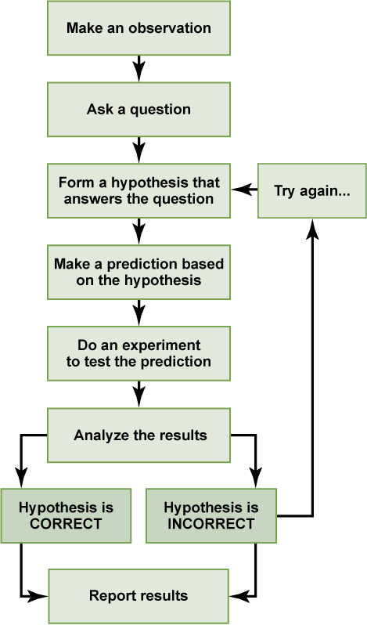

Slide 13
Forming a Research Question
Many questions arise from daily experience.
Aggression
Do violent TV shows affect aggression levels?
How about violent video games?
Aggression and anxiety are psychological constructs. (Construct – idea that cannot be seen or measured directly) B/c of this definition, it is best if research questions are directed toward behavior.

Slide 14
Forming a Hypothesis
An educated guess is formed after psychologists have created a research question
The accuracy is then tested by research.

Slide 15
Testing the Hypothesis
To test the hypothesis that two fighting fish would attack each other, the most efficient method would probably be to put two fighting fish in the same tank.

Slide 16
Analyzing the Results
After psychologists have tested their hypothesis, they analyze their results.
What do the findings mean?
To have accurate results, psychologists often gather data over weeks, months, and sometimes years. And they gather a multitude of data.

Slide 17
Drawing Conclusions
Once psychologists have analyzed the data, they draw conclusions about their question and hypothesis.
Psychologists must:
Keep an open mind
Must change their theories or beliefs from the hypothesis if it doesn’t match
Ex: the fighting fish did not fight in the tank

Slide 18
Is your experiment and study over now?

Slide 19
2 more steps
Replication
Study must be repeated with the same results
New Questions
What new questions did your experiment lead to?
EX: Are there any circumstances under which fighting fish do not attach each other?

Slide 20
Hawthorne Effect
https://www.youtube.com/watch?v=W7RHjwmVGhs
When are people most productive?
With a teacher/parent/boss hovering over their shoulder
Left alone to work

Slide 21
Case Study pg. 32-33
On your own sheet of paper, copy down the questions and answers:
What flaws did the Hawthorne study have, and how did these flaws affect the study’s outcome?
What is the Hawthorne effect, and why do some people question its existence?

Slide 22
The Hawthorne effect refers to the inclination of some people to work harder and perform better when they are being observed as part of an experiment.

Slide 23
Look over Section 1
Answer Section 1 Questions

Slide 24
Daily Opener
List one television show that you liked that has either ended or been canceled. Explain the reason for the show’s closure.
Today’s Agenda
Daily Opener – Read on page 38
Quiz
Notes
Student News
Extra Credit ?
Observation/Flash Cards
Index Card Activity – 6 methods of Observation pages 46-47

Slide 25
Quiz?
Why must a study be replicated?
List the steps in scientific research in the correct order.
Why is it best not to base a research question on a psychological construct?
Explain the findings in the Hawthorne study.
Who was Rene Descartes?

Slide 26
Surveys, Samples, and Populations
Survey – people are asked to respond to a series of questions about a particular subject
Questionnaire
Interview
Target population – the whole group you want to study or describe
Sample – only part of the target population

Slide 27
Samples
Random sample – individuals are selected by chance from the target population
Stratified sample – subgroups in the population are represented proportionally in the sample
For example, about 12% of the American population is African American. A stratified sample would be about 12% African American.

Slide 28
A large random sample is likely to be accurately stratified even if researchers take not special steps to ensure that it is.
Volunteers

Slide 29
Volunteer Bias
People who volunteer to participate in studies may bring with them a volunteer bias – that is, they may have a different outlook from people who do not volunteer for research studies.
Volunteers are usually more willing than other people to disclose personal info and are often more interested in research.

Slide 30
For Example:
A survey in Glamour magazine asks readers, the following questions:
‘How much time do you spend reading magazines?’
‘Do you enjoy reading?’
‘How much leisure time do you have per week?’
Will this survey accurately report American interests and leisure times? What will this survey show?

Slide 31
Volunteer Bias
Look up and write a definition for volunteer bias.

Slide 32
Think about and/or Discuss your answers:
Do you have good morals?
Are you an ethical person?
Are you obedient?
Would you stand up for someone who was being threatened or abused if:
There was NO chance of physical harm befalling you
There was a chance of physical harm befalling you

Slide 33
Milgram Experiment
https://www.youtube.com/watch?v=W147ybOdgpE

Slide 34
Experimental Issues

Slide 35
Topics
Animal cruelty
Treatment of people
Informed consent
Deception

Slide 36
Key Terms
Variables –
Independent variables –
Dependent variable –
Experimental group –
Control group-

Slide 37
Variables – factors that can vary or change
Independent variables –the factor that the researcher manipulates so that they can determine its effect
Dependent variable –depends on something – the independent variable
Experimental group – receive the treatment
Control group- do not receive the treatment

Slide 38
Placebo
A substance or treatment that has no effect apart from the person’s belief in it’s effect

Slide 39
Single Blind Study
The researcher knows, participants do not know

Slide 40
Double Blind Study
Researcher and participants do not know
(Experiment Organizer knows)

Slide 41
Standard Deviation
Is a measure of distance of every score to the mean. The larger the standard deviation the more spread out the scores are.

Slide 42
Pop Quiz

Slide 43
Pop Quiz – Don’t use notes, phone, books, friends. Only your brain.
List the steps in a scientific study.
Give an example of a stratified sample.
What is a placebo?
Define standard deviation.

Slide 44
Daily Opener:
Define Ethics.

Slide 45
Ethical Issues
Ethics – standards for proper and responsible behavior

Slide 46
Specific ethical guidelines have been established by the American Psychological Association (APA).
Look up the APA and write a paragraph about it.

Slide 47
Psychologists use:
Confidentiality – records are private
Informed consent – people agree or consent
Deception - keeping participants unaware of the treatment

